Slide 1
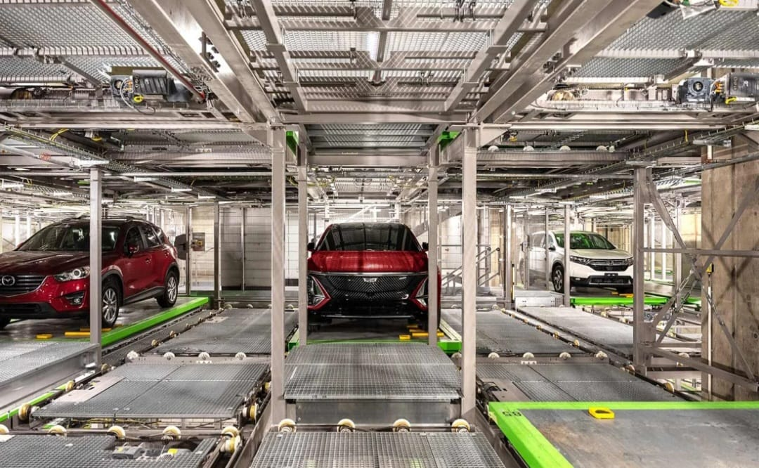
GROUP PROJECT
Presented by APPLE GROUP A
[ Group illustration ]

Slide 2
THE GROUP MEMBERS
Opare Kwame Aaron
Opoku George Asafo-Adjei
Opoku Otis
Tsegah Jemima Dorothy
Tuffour Nana Opoku
Tulasi Stanley Selasi
Quarshie William
Quaye Sadick Abbey
Wiafe Akenten Kelvin
Quansah Karen Amankwah
Qeuce John Herbert

Slide 3
SLIDE 1: TITLE & TEAM
Project Title: Smart Parking System
Lab/Skill Area Used (Arduino, Web Development, CAD)
Date of Presentation: 31st March, 2026

Slide 4
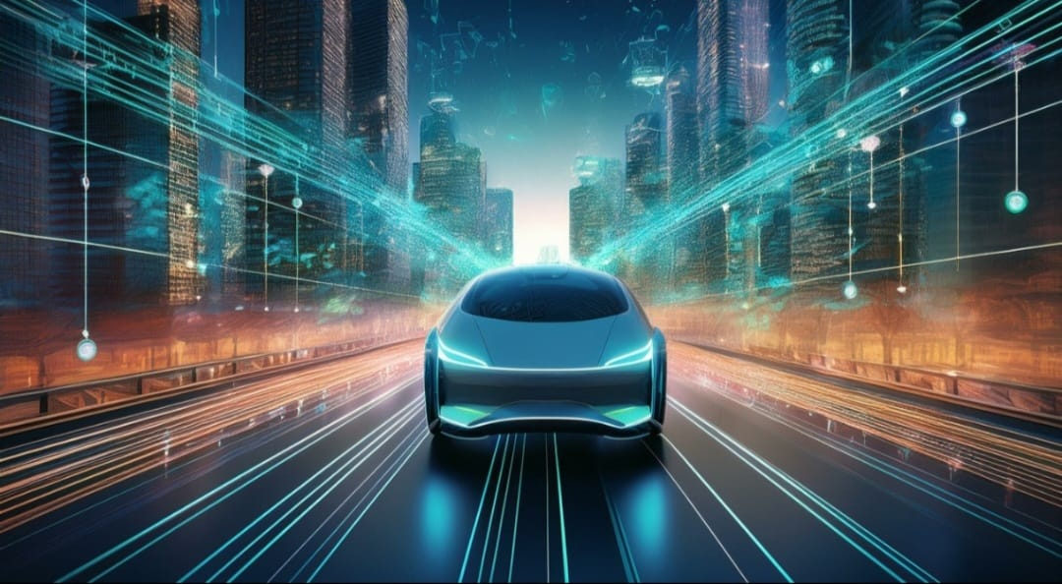
SLIDE 2: INTRODUCTION
Problem: Difficulty finding parking spaces
CE Role/Importance: Embedded systems + automation
Relevant context/statistics:20–30% of driving time wasted on parking search
[ Illustration ]

Slide 5
SLIDE 3: OBJECTIVES
Primary Goal
CE Impact
Design smart parking assist system infrastructure
- Improve safety and efficiency
Integrate sensors + web interface
Support Smart city

Slide 6
SLIDE 4: PROBLEM STATEMENT
Problem Solving: Drivers struggle to find parking
Why this problem matters: Leads to congestion and delays affects safety and efficiency

Slide 7
SLIDE 5: METHODS / APPROACH
Sensor-based detection using Arduino
CAD modelling for system structure

Slide 8

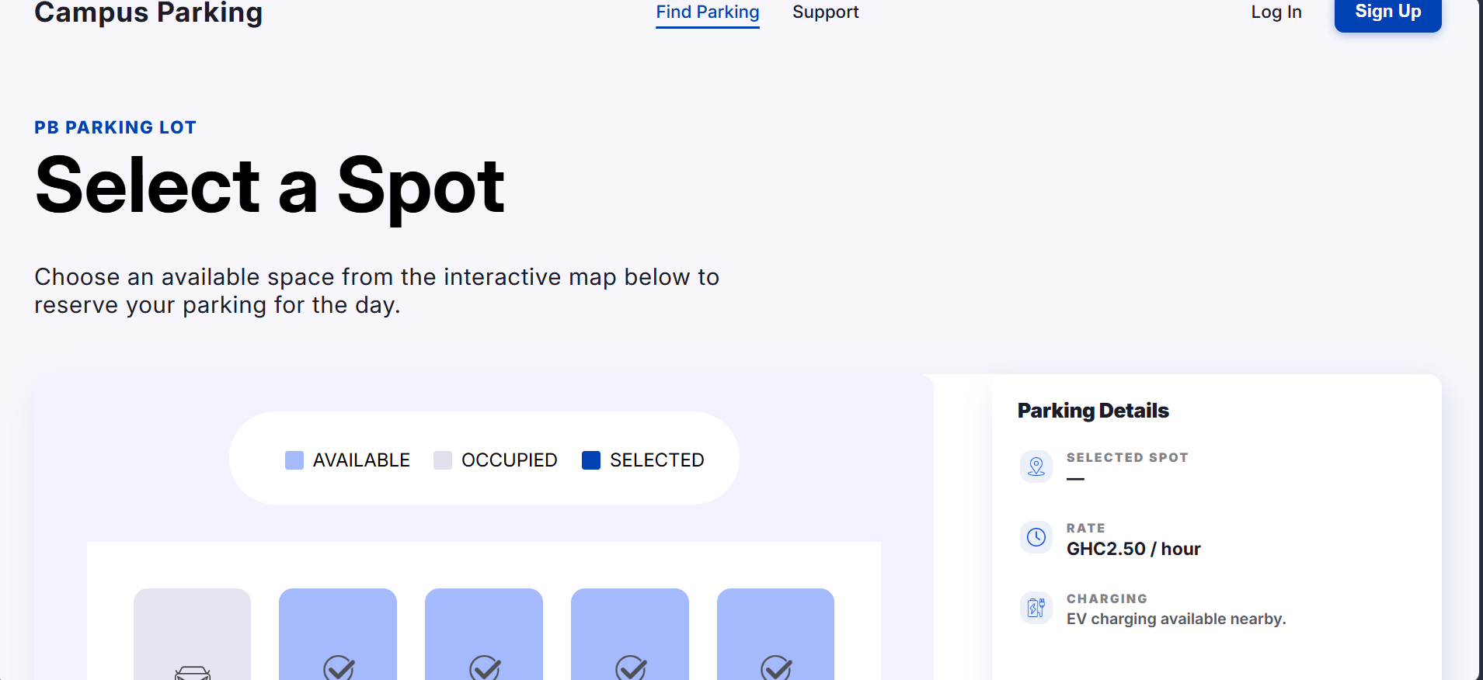

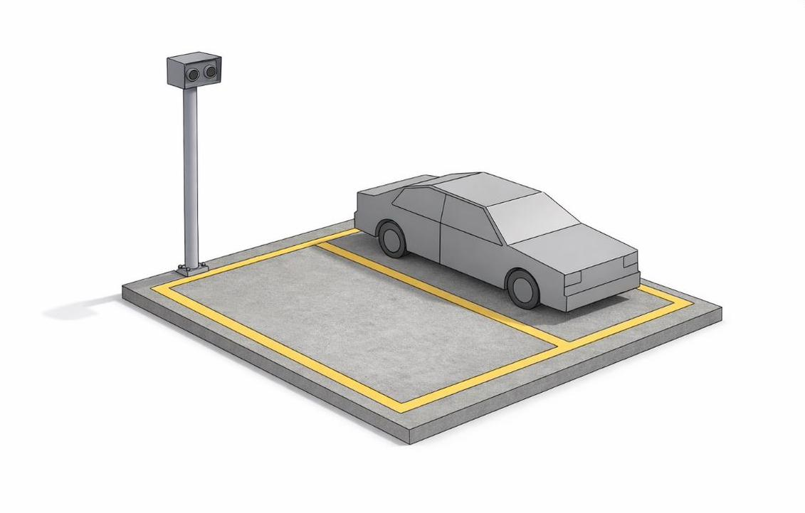
SLIDE 6: RESULTS / DEMONSTRATION
Arduino
Web Development
Photo/video of the working circuit or sensor readings
Screenshot of the web application or interface
CAD with SolidWorks
3D view (orthographic or isometric) of your model

Slide 9
SLIDE 7: DISCUSSION
What worked well ?: System performed as expected
Any challenges encountered: Minor calibration improvements possible
How your project could be improved:Future testing will refine accuracy

Slide 10
SLIDE 8: RECOMMENDATIONS
- Recommendations: Add mobile app integration
- How it could be useful in real CE setting: Enable GPS tracking
Use AI for prediction.
Improves safety and navigation

Slide 11
SLIDE 9: REFERENCES (IF ANY)
Arduino Docs
Web Dev Resources
CAD Tutorials

Slide 12
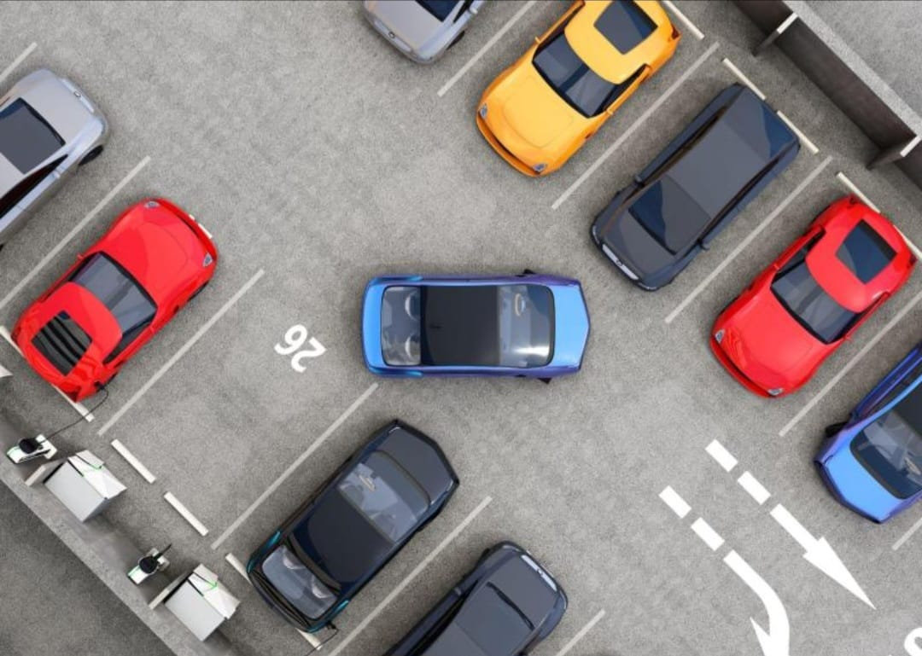
THANK YOU
Any Questions?
[ Group illustration ]

